Slide 1


Solution By: Return Zero
PSID:INTL-DA-07
Team Leader Name: Surendhar R

Slide 2

Idea Introduction
IDEA TITLE- BASELINE
Tech Stack
1. Python
2. Power BI
Resources Used
1. Microsoft Power BI documentation
2. Google Colab
Any Third Party API/Services used
No
IDEA-OUTCOME – HEADLINE-
Our system will be able to identify the crime prone areas so that the police can concentrate more on security of the locations along with that we would be able to forecast on the number of crimes that will happen on that particular day .

Slide 3
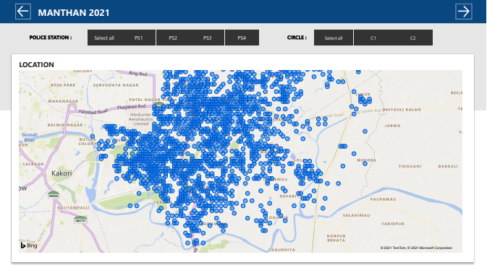
Your Approach Towards Idea
Write Your Approach in Brief below
First we analyzed the significant parameters and questions that has to be answered through data exploration. Then we created dashboards that represents the same . After each iterative cycle we improved the efficiency by adding more useful insights and tuned the hyper parameters for better solutions
Instead of giving just an predictive system might not help In better insights development so we added analysis of crime rates , events the sources from which it was reported so that it’s more easy to find new ways to improve the retention of crime
We targeted the problem in 2 major ways . One way is to analyze the key areas of crime and other one is to forecast the crime rate per day in the near future
If we have more diverse data from different districts the system would derive analysis even better
Notes:
Use any image of your proposed solution here instead of this macbook image

Slide 4







Team Slide
Surendhar R
Rajalakshmi Engineering College
Team Leader
Charann A
Rajalakshmi Engineering College
Team Member
Ashwin Prasad H
Rajalakshmi Engineering College
Team Member
Raja Arvindan R
Rajalakshmi Engineering College
Team Member
Anjana S
Rajalakshmi Engineering College
Team Member
PV Rajaraman
Rajalakshmi Engineering College
Team Mentor

Slide 5
Development Pipeline
Documents To be prepared for installation and evaluation
1. Microsoft Power BI Documentation.
Any Third party API used, if yes please specify
No
Proposed UI and functional flow in pointers
Filters and Buttons for navigations in Power BI
Different colour themes for better view of analysis
Repository Link or Any references link of folders
https://github.com/surendhar-code/MANTHAN-HACKATHON-2021---IDENTIFICATION-OF-CRIME-PRONE-AREAS
Proposed Development Plan in pointers
1. Problem statement analysis
2. Data Cleaning
3. Data Exploration
4. Model Building
5. Interpretation of
Results as dashboards
Step A
Step B
Step C
Step D
Step E

Slide 6
Vision of Innovation/Idea/Solution
We developed our idea by first jotting down the key aspects that needs to be answered . After that we cleaned the data and prepared it for analysis. Then we represented analysis through Power BI tool and derived solutions are then proposed
Our solution not only provides future forecast but it also provides locations where crimes happen the most along with an insightful analysis on crimes and events happened
We have implemented the analysis , forecasting for the dataset given for the district of Lucknow which took around 6 hrs to prepare and process the data to useful insights. So if more data of diverse districts are given it might take upto 3-4 days for better products
Early stage innovation that we identified is the ability of the system to derive locations based on the latitude and longitude given and find the peak spots where most crimes have been reported.

